Slide 1
SS ZG 526: Distributed Computing
Global State Recording
Chittaranjan Hota
Professor, Dept. of Computer Sc. & Information Systems
BITS, Pilani Hyderabad Campus, Hyderabad
hota@hyderabad.bits-pilani.ac.in

Slide 2
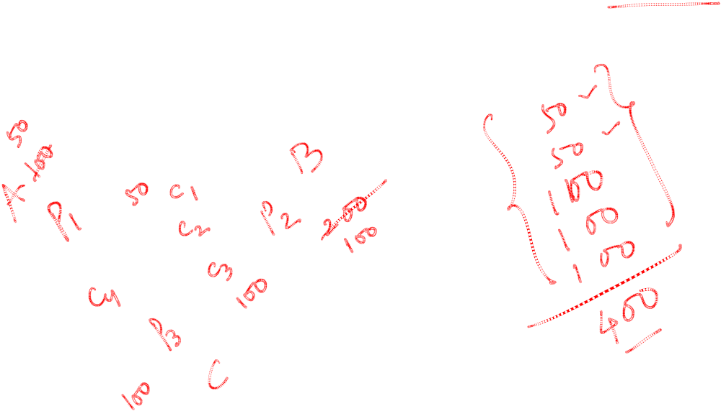
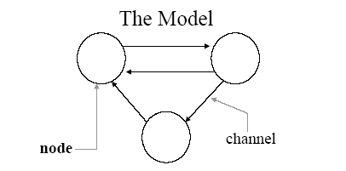
Global state recording
Recording the global state of a distributed system on-the-fly is an important problem.
Why is it non-trivial?
Birla Institute of Technology and Science, Pilani (Deemed University)

Slide 3

Uses of Global State Recording
Recording a “consistent” state of the global computation
  checkpointing in fault tolerance (rollback, recovery)
Detecting stable properties in a distributed system via snapshots. A property is “stable” if, once it holds in a state, it holds in all subsequent states.
  termination detection
  deadlock detection
  …
Birla Institute of Technology and Science, Pilani (Deemed University)

Slide 4

Issues in recording a global state
The following two issues need to be addressed:
I1: How to distinguish between the messages to be recorded in the snapshot from those not to be recorded?
-Any message that is sent by a process before recording its snapshot, must be recorded in the global snapshot.
-Any message that is sent by a process after recording its snapshot, must not be recorded in the global snapshot.
I2: How to determine the instant when a process takes its snapshot?
-A process p_{j} must record its snapshot before processing a message m_{ij} that was sent by process p_{i} after recording its snapshot.
Birla Institute of Technology and Science, Pilani (Deemed University)

Slide 5

Difficulties due to Non-determinism
Deterministic Computation
- At any point in computation there is at most one event that can happen next.
Non-Deterministic Computation
- At any point in computation there can be more than one event that can happen next.
Birla Institute of Technology and Science, Pilani (Deemed University)

Slide 6
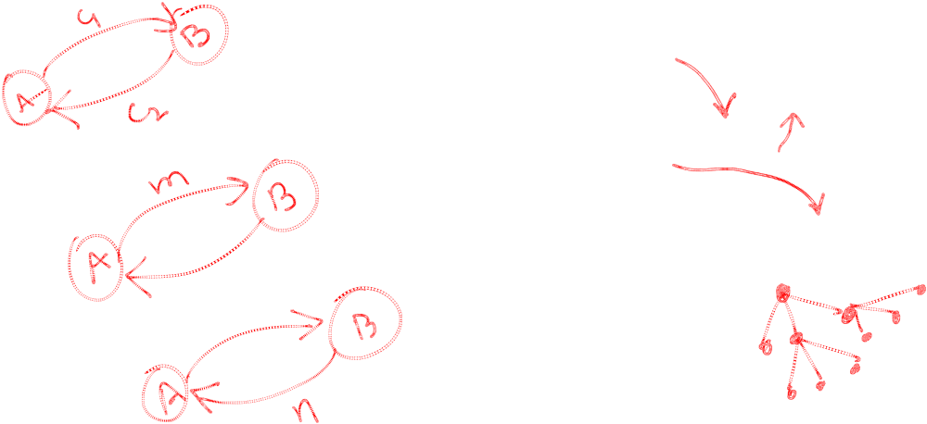
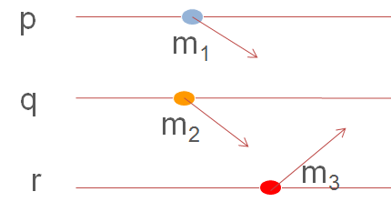
Example
Non-deterministic
Deterministic
Birla Institute of Technology and Science, Pilani (Deemed University)

Slide 7
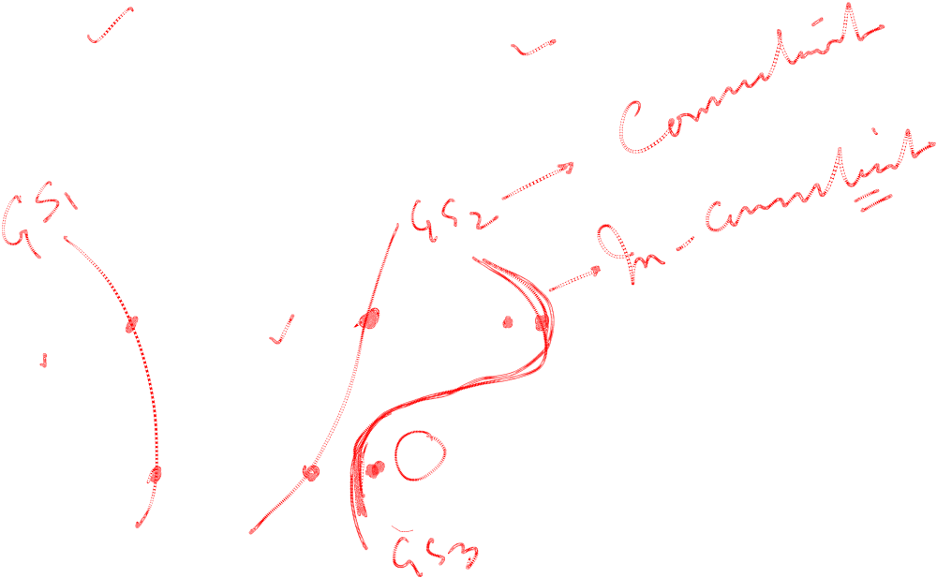
Consistent/ In-consistent global states
p
q
p
m₂
m₁
m₃
q
Birla Institute of Technology and Science, Pilani (Deemed University)

Slide 8
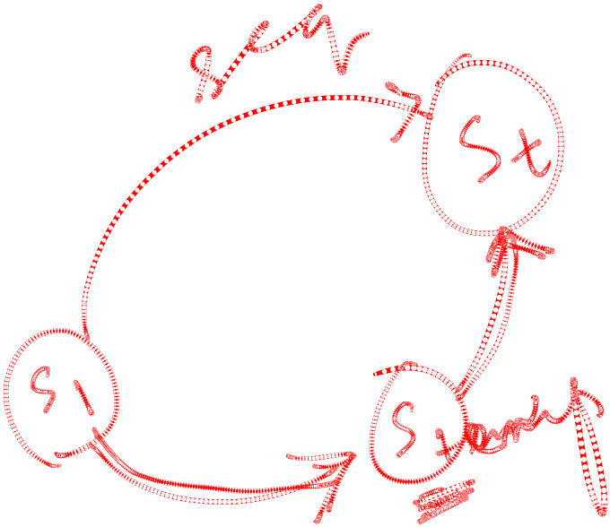
Properties of the recorded global state
The recorded global state may not correspond to any of the global states that occurred during the computation.
This happens because a process can change its state asynchronously before the markers it sent are received by other sites and other sites record their states.
  But the system could have passed through the recorded global states in some equivalent executions.
Birla Institute of Technology and Science, Pilani (Deemed University)

Slide 9
Next session
Chandy Lamports’ Global state recording algorithm
Birla Institute of Technology and Science, Pilani (Deemed University)

